Slide 1
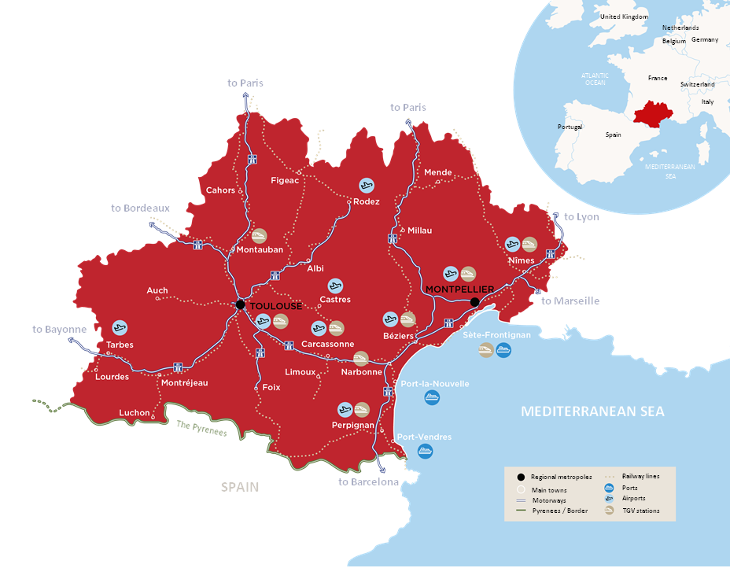
OCCITANIE in the south of France
One of Europe’s most
attractive regions
6 million
inhabitants
+50,000
new
inhabitants per year
Toulouse
Montpellier
Frankfurt 1h45
Algiers 1h15
London 1h55
Marseille 1h35
Amsterdam 1h55
Lyon 1h40
Bordeaux 2h10
Paris 3h15
Paris 4h15
Barcelona 3h20

Slide 2
OCCITANIE
Pioneering the shift to a more responsible world
VISIONARY
a spirit of innovation, the future is already here
MONTPELLIER
INGENIOUS
brimming with talent
and know-how
TOULOUSE
COMMITTED
respect for the resources
of the planet
WELCOMING
AND SUPPORTIVE
no-one is left behind

Slide 3
Sectors of excellence
IN OCCITANIE
AERONAUTICS
World leader in aeronautics, where green aircraft is about to take off
DIGITAL
AI, high performance calculation, cybersecurity, spatial data…
AGRICULTURE & FOOD
High quality, organic and
innovation-oriented products
SPACE
Main hub for European space activities.
Occitanie, one step ahead
CULTURAL AND CREATIVE INDUSTRIES
New imaginary worlds come to life
TOURISM
Committed to sustainability
SEA
The blue economy sets sail for success
RENEWABLE ENERGIES
On the way to becoming the 1st “positive
Energy” region in Europe
SMART AND SUSTAINABLE
MOBILITY
Decarbonising transport with innovative solutions
HEALTHCARE
World excellence hub for oncology & one Health
HIGHER EDUCATION AND RESEARCH
Training new talent and shaping future skills

Slide 4
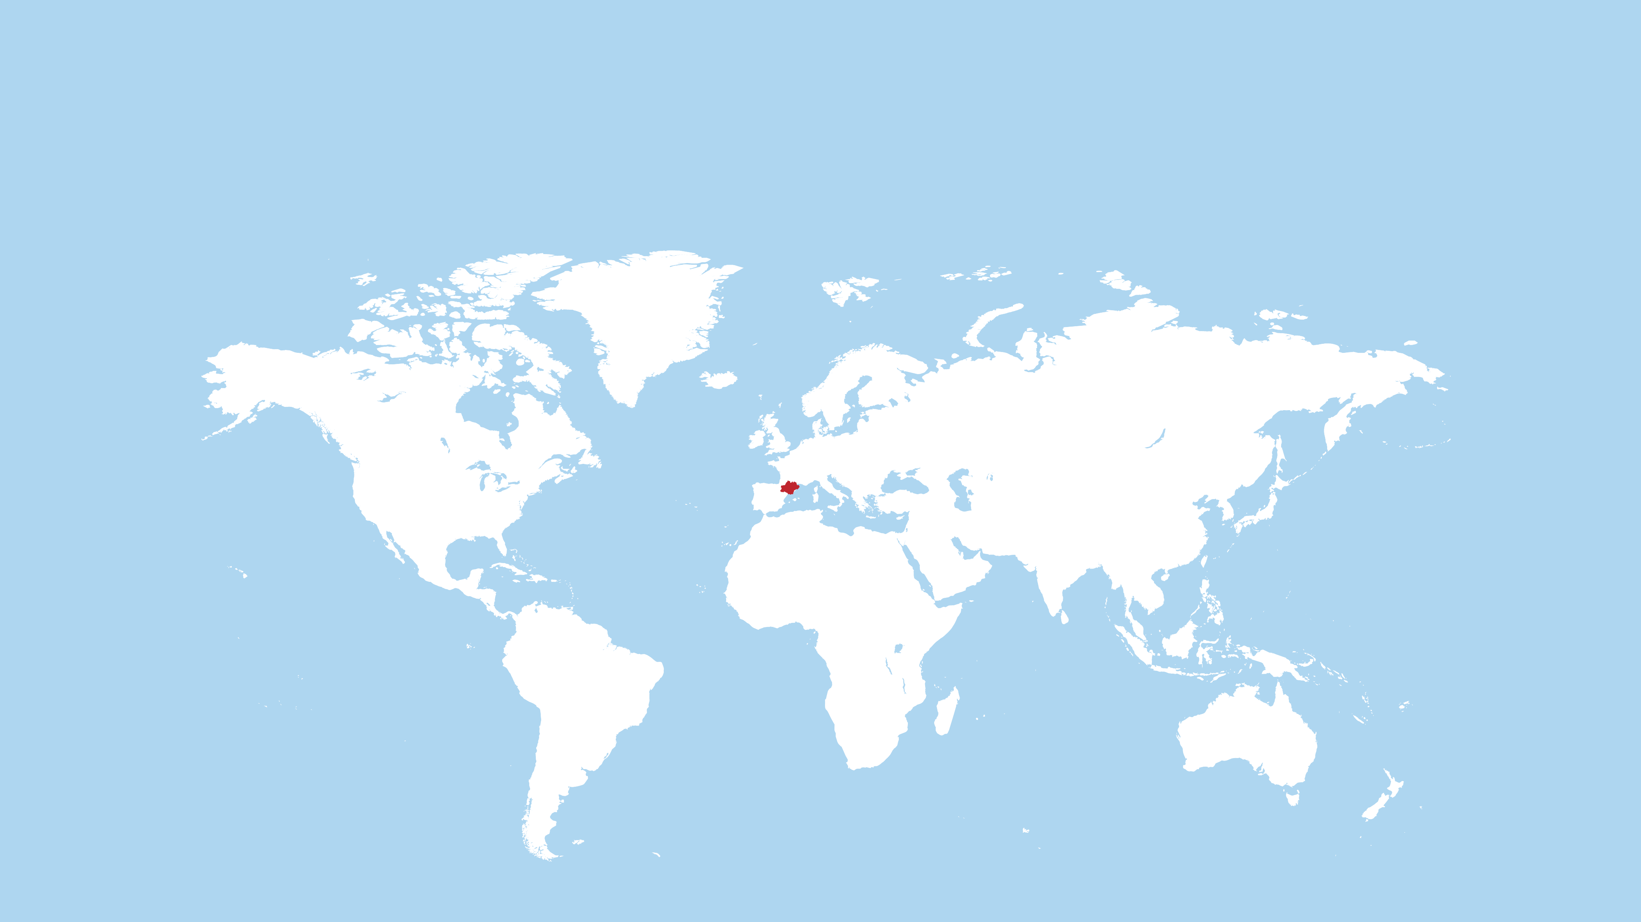
Open to the world with 6 representative offices worldwide: Maisons de l'Occitanie
BRUSSELS
HAMBURG
SHANGHAI
NEW-YORK
CASABLANCA
TOKYO

Slide 5
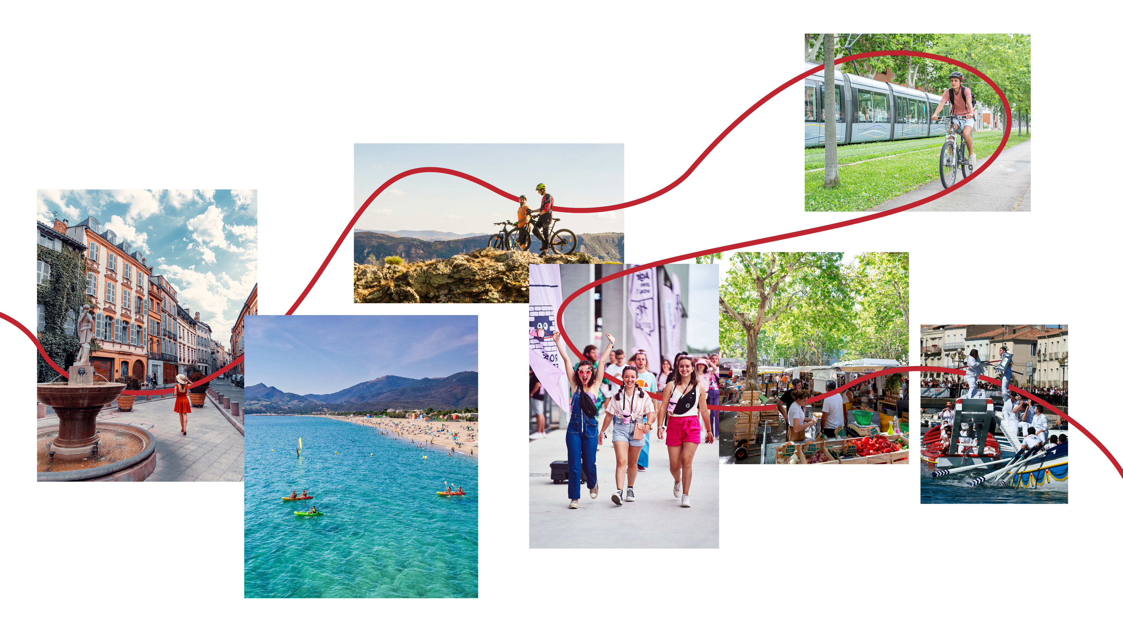
OCCITANIE
High quality infrastructures and attractive lifestyle
WORTH EXPLORING
AUTHENTIC
TEAM SPIRIT
CAREFUL
WELCOMING

